Slide 1
CSE 460: VLSI Design (Lab)
Experiment 4
Simulation of Mealy and Moore Type FSMs in Verilog

Slide 2

Finite State Machine
In Combinational logic circuits, outputs are determined solely by the present values of the inputs.
In Sequential circuits, outputs depend both on the past behavior of the circuit and the present values of the inputs. The storage elements in terms of flip-flops can reserve the state information of the logic circuit at any given time.
The sequential circuits in which a clock signal is used to control the operation of the circuit, is called synchronous sequential circuits. These synchronous sequential circuits are known in general as Finite State Machines (FSMs).
The building blocks of a finite state machine are combinational circuits and one or more flip-flops. Under the control of the clock signal, the flip-flops change their state as determined by the combinational logic.
Combinational
circuit
Flip-flops
Combinational
circuit
W
Q
Z
Clock

Slide 3
Finite State Machine
FSMs can be of two types:
Moore type FSM
The sequential circuits whose outputs depend only on the states of the circuit are of Moore type.
Mealy type FSM
The sequential circuits whose outputs depend on both the state and the present primary inputs are of Mealy type
Combinational
circuit
Flip-flops
Combinational
circuit
W
Q
Z
Clock

Slide 4
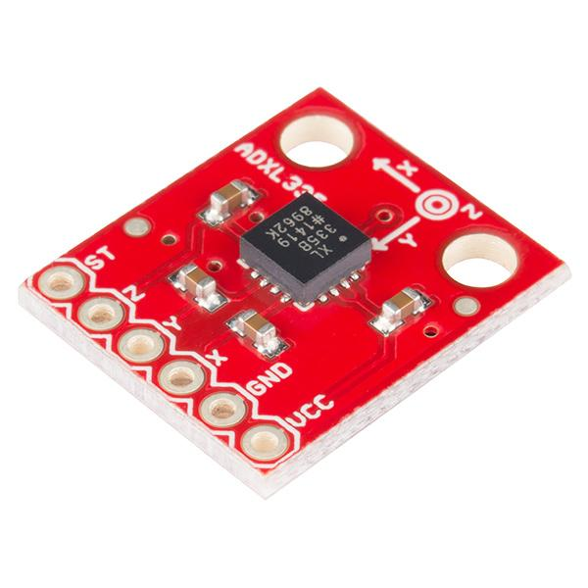
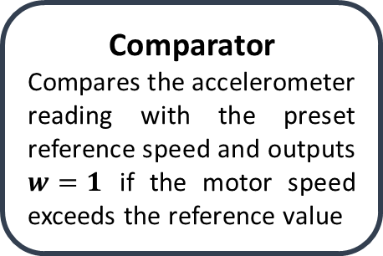
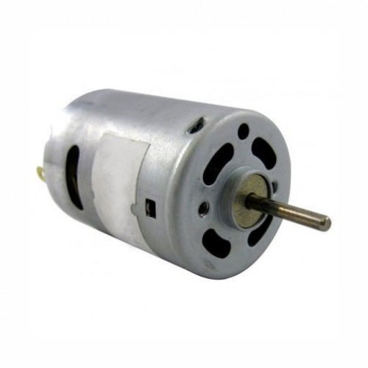

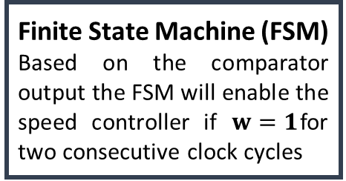
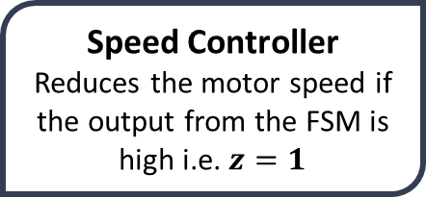
FSM based motor speed controller
Accelerometer
Motor speed
(rpm)
w
DC motor
z

Slide 5
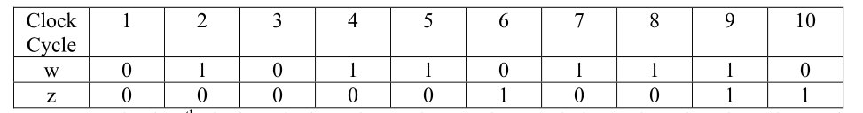
Moore Type FSM
Problem:
Suppose that we wish to design a circuit that meets the following specification:
The circuit has one input, w, and one output, z.
All changes in the circuit occur on the positive edge of a clock signal.
The output z is equal to 1 if during two immediately preceding clock cycles the input w was equal to 1. Otherwise, the value of z is equal to 0.
Input-output combination:

Slide 6

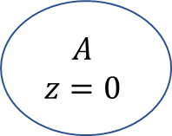
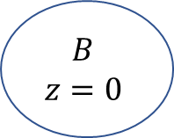




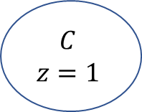

Moore Type FSM
Reset
Present State | Next State |  | Output z
 | w=0 | w=1
A | A | B | 0
B | A | C | 0
C | A | C | 1
Figure : State Table
Figure : State Diagram

Slide 7
Moore Type FSM
Reset
 | Next State |  | Output z
 | w=0 | w=1
00(A) | 00(A) | 01(B) | 0
01(B) | 00(A) | 10(C) | 0
10(C) | 00(A) | 10(C) | 1
11 | dd | dd | d
Figure : State Diagram

Slide 8






General Circuit Diagram of the FSM
Combinational
circuit
FF-1
Combinational
circuit
 | Next State |  | Output z
 | w=0 | w=1
00 | 00 | 01 | 0
01 | 00 | 10 | 0
10 | 00 | 10 | 1
11 | dd | dd | d
FF-2
Clock

Slide 9







Designing the FSM in Verilog
Combinational circuit synthesis in Verilog
always@(*)blocks are used to describe combinational logic in Verilog. Blocking assignment statements are to be used inside these blocks.
always@(*)
begin
C = A & B;
end
In order to design the FSM using Verilog we will need to perform the following steps:
Assigning binary variables to states
A mechanism for figuring out the current state (Sequential circuit block)
Defining the logic for state transition (Combinational circuit block)
Defining the output for the current state (Continuous assignment statement)
Sequential circuit synthesis in Verilog
always@(posedge clk) or always@(negedge clk) blocks are used to describe combinational logic in Verilog. Non-blocking assignment statements are to be used inside these blocks.
always@(posedge clk) begin
Q <= D;
end
FF

Slide 10
Moore Type FSM
 | Next State |  | Output z
 | w=0 | w=1
00(A) | 00(A) | 01(B) | 0
01(B) | 00(A) | 10(C) | 0
10(C) | 00(A) | 10(C) | 1
11 | dd | dd | d

Slide 11
module Moore11 (Clock, Resetn, w, z,y,Y);
input Clock, Resetn, w;
output reg z;
output reg [2:1] y, Y;
parameter [2:1] A = 2'b00, B = 2'b01, C = 2'b10;
// Define the next state combinational circuit
always @(w, y)
case (y)
A: if (w) Y = B;
else Y = A;
B: if (w) Y = C;
else Y = A;
C: if (w) Y = C;
else Y = A;
default: Y = 2'bxx;
endcase
// Define the sequential block
always @(negedge Resetn, posedge Clock) begin
if (Resetn == 0) y <= A;
else y <= Y;
end
// Define output
always@(y) begin
case (y)
A: z=0;
B: z=0;
C: z=1;
endcase
end
endmodule

Slide 12
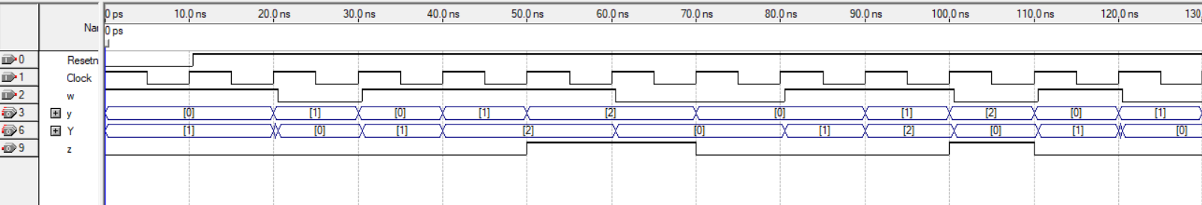
Moore Type FSM
Steps for properly inserting inputs (w as well as resetn):
1. first invert the Clock signal
2. Introduce now a small offset(0.5ns) in both w and Resetn signals
Video link : https://youtu.be/ZdOeTZLUr0Q?feature=shared

Slide 13
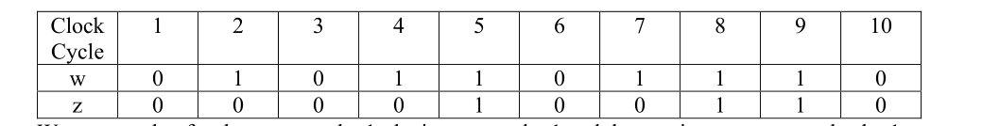
Mealy Type FSM
Problem:
We wish to design a circuit that meets the following specification:
The circuit has one input, w, and one output, z.
All changes in the circuit occur on the positive edge of a clock signal.
The output z is equal to 1 if during two immediate clock cycles the input w was equal to 1. Otherwise, the value of z is equal to 0.
Input-output combination:

Slide 14

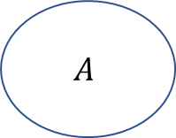
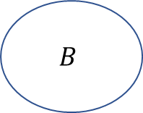



Mealy Type FSM
Reset
Present State | Next State |  | Output z
 | w=0 | w=1 | w=0 | w=1
A | A | B | 0 | 0
B | A | B | 0 | 1
Figure : State Table
Figure : State Diagram

Slide 15
Mealy Type FSM
Present State | Next State |  | Output z
 | w=0 | w=1 | w=0 | w=1
A | A | B | 0 | 0
B | A | B | 0 | 1
Present State | Next State |  | Output z
y
 | w=0 | w=1 | w=0 | w=1
 | Y | Y
0(A) | 0(A) | 1(B) | 0 | 0
1(B) | 0(A) | 1(B) | 0 | 1
Figure : State Table
Figure : State-assigned Table

Slide 16
module Mealy11 (Clock, Resetn, w, z,y,Y);
input Clock, Resetn, w;
output reg z;
output reg y, Y;
parameter A = 1'b0, B = 1'b1;
// Define the next state and output "combinational" circuits
always @(w, y)
case (y)
A: if (w)
begin
z = 0;
Y = B;
end
else
begin
z = 0;
Y = A;
end
B: if (w)
begin
z = 1;
Y = B;
end
else
begin
z = 0;
Y = A;
end
endcase
// Define the sequential block
always @(negedge Resetn, posedge Clock) begin
if (Resetn == 0) y <= A;
else y <= Y;
end
endmodule

Slide 17
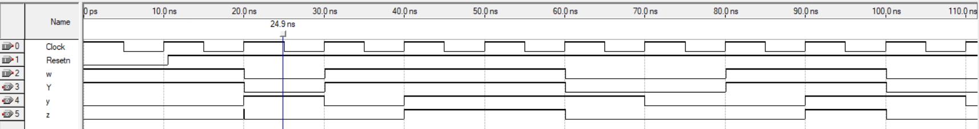
Steps for properly inserting inputs (w as well as resetn):
1. first invert the Clock signal
2. Introduce now a small offset(0.5ns) in both w and Resetn signals

Slide 18
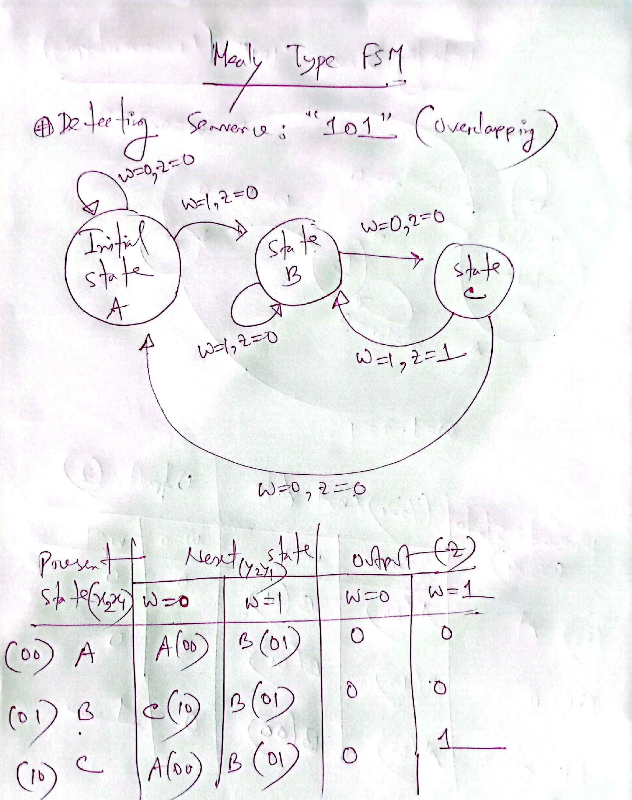
module Mealy101(Clock, Resetn, w, z,y,Y);
input Clock, Resetn, w;
output reg z;
output reg [1:0]y, Y;
parameter A = 2'b00, B = 2'b01, C= 2'b10;
// Define the next state and output "combinational" circuits
always @(w, y)
case (y)
A: if (w)
begin
z = 0;
Y = B;
end
else
begin
z = 0;
Y = A;
end
B: if (w)
begin
z = 0;
Y = B;
end
else
begin
z = 0;
Y = C;
end
C: if (w)
begin
z = 1;
Y = B;
end
else
begin
z = 0;
Y = A;
end
endcase
// Define the sequential block
always @(negedge Resetn, posedge Clock) // Asynchronous reset
begin
if (Resetn == 0) y <= A;
else y <= Y;
end
endmodule

Slide 19
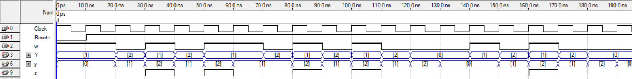
Steps for properly inserting inputs (w as well as resetn):
1. first invert the Clock signal
2. Introduce now a small offset(0.5ns) in both w and Resetn signals

Slide 20
For Practice at home

Slide 21
An Example (Moore type)
Problem: Derive the state diagram for an FSM that has an input w and an output z. The machine has to generate z = 1 when the previous four values of w were 1001 or 1111; otherwise, z = 0.Overlapping input patterns are allowed. An example of the desired behavior is
Clock cycle | 1 | 2 | 3 | 4 | 5 | 6 | 7 | 8 | 9 | 10 | 11 | 12 | 13 | 14 | 15 | 16 | 17
w | 0 | 1 | 0 | 1 | 1 | 1 | 1 | 0 | 0 | 1 | 1 | 0 | 0 | 1 | 1 | 1 | 1
z | 0 | 0 | 0 | 0 | 0 | 0 | 0 | 1 | 0 | 0 | 1 | 0 | 0 | 0 | 1 | 0 | 0

Slide 22



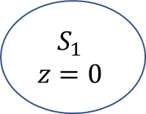





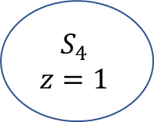










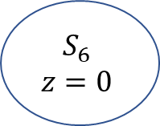



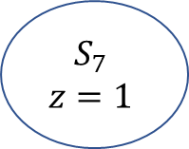

State diagram(Moore type)
Reset

Slide 23
State table (Moore type)
Present State | Next State |  | Output z
 | w=0 | w=1
S0 | S0 | S1 | 0
S1 | S5 | S2 | 0
S2 | S5 | S3 | 0
S3 | S5 | S4 | 0
S4 | S5 | S4 | 1
S5 | S6 | S1 | 0
S6 | S0 | S7 | 0
S7 | S5 | S2 | 1
 | Next State |  | Output z
 | w=0 | w=1
000(S0) | 000(S0) | 001(S1) | 0
001(S1) | 101(S5) | 010(S2) | 0
010(S2) | 101(S5) | 011(S3) | 0
011(S3) | 101(S5) | 100(S4) | 0
100(S4) | 101(S5) | 100(S4) | 1
101(S5) | 110(S6) | 001(S1) | 0
110(S6) | 000(S0) | 111(S7) | 0
111(S7) | 101(S5) | 010(S2) | 1
Figure : State Table
Figure : State-assigned Table

Slide 24
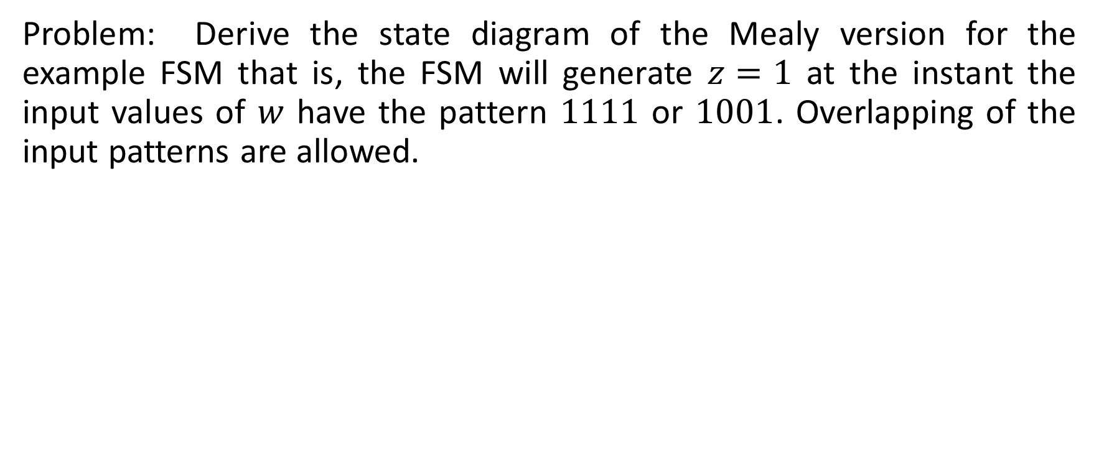
An Example (Mealy type)
Clock cycle | 1 | 2 | 3 | 4 | 5 | 6 | 7 | 8 | 9 | 10 | 11 | 12 | 13 | 14 | 15 | 16 | 17
w | 0 | 1 | 0 | 1 | 1 | 1 | 1 | 0 | 0 | 1 | 1 | 0 | 0 | 1 | 1 | 1 | 1
z | 0 | 0 | 0 | 0 | 0 | 0 | 1 | 0 | 0 | 1 | 0 | 0 | 0 | 1 | 0 | 0 | 1

Slide 25






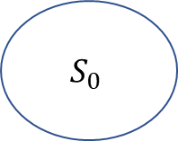


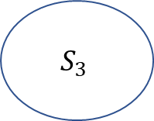
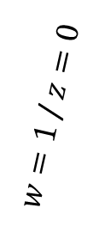



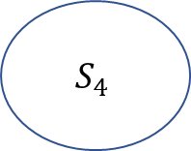




State diagram(Mealy type)
Reset

Slide 26
State table (Mealy type)
Present State | Next State |  | Output z
 | w=0 | w=1 | w=0 | w=1
S0 | S0 | S1 | 0 | 0
S1 | S4 | S2 | 0 | 0
S2 | S4 | S3 | 0 | 0
S3 | S4 | S3 | 0 | 1
S4 | S5 | S1 | 0 | 0
S5 | S0 | S1 | 0 | 1
 | Next State |  | Output z
 | w=0 | w=1 | w=0 | w=1
000(S0) | 000(S0) | 001(S1) | 0 | 0
001(S1) | 100(S4) | 010(S2) | 0 | 0
010(S2) | 100(S4) | 011(S3) | 0 | 0
011(S3) | 100(S4) | 011(S3) | 0 | 1
100(S4) | 101(S5) | 001(S1) | 0 | 0
101(S5) | 000(S0) | 001(S1) | 0 | 1
Figure : State Table
Figure : State-assigned Table

